Slide 1

Title of Project
Automatic Traffic E-challan Generation Using Computer Vision
Presentation by
Shrayank Mistry (B150234309)
Parag Nankar (B150234318)
Gaurav Patil (B150234334) Prathamesh Tambe (B150234390)
Group No :- 50
Guided by
Prof. M. R. Dhage
Department of Computer Engineering
Sinhgad College of Engineering, Vadgaon (Bk), Pune
SCOE, Department of Computer Engineering

Slide 2
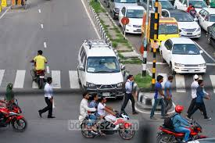
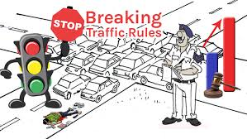
Problem Statement
Detection of Vehicle Number Plate & E-challan Generation on Rule Violation by Using Computer Vision

Slide 3
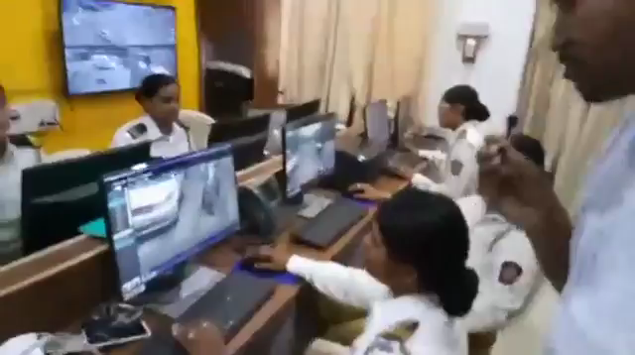
Motivation
Human Intervention for violation of rule detection
Automation of system
Applicable on many Signals
On going System

Slide 4
Primary Objectives
Pre-processing:
Capture Image
Number plate identification
Feature Extraction:
Number plate pre-processing
Classification (using Tesseract)
Verification:
Database Verification
E-challan Generation

Slide 5
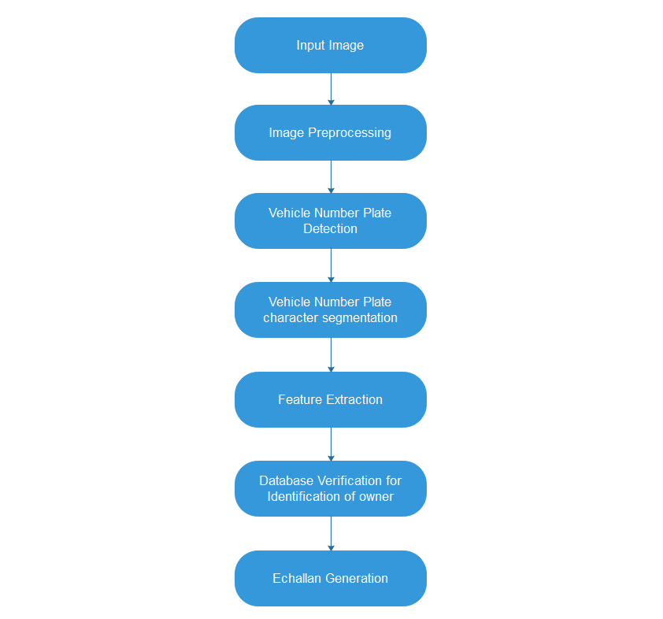
System Overview

Slide 6
Literature Review
License Plate Detection and Localization in Complex Scenes Based on Deep-Learning IEEE 2018
Methodology :
Convolutional neural network(CNN) is used to recognize the license plate by converted object detection problem into a binary classification problem.
Candidate regions are generated on the sliding window by using selective search algorithm.
Finally, Support Vector Machine is used for classification.
Accuracy & Results : Compared with license plate detection in traditional machine learning, it has obvious advantages in detection accuracy, especially for complex scenes, the positioning accuracy has been improved significantly.

Slide 7
Characters Feature based Indian Vehicle License Plate Detection and Recognition IEEE 2017
Methodology :
Adaptive preprocessing.
Segmentation of character were done using vertical and horizontal projection of the extracted license plate.
Feature vector is extracted from the boundary analysis of the character.
Finally character recognition were done using K-nearest neighbor classifier based on feature vector.
Accuracy & Results : This paper, the presented approach is effectively able to extract single line license plate and feature extraction technique which is based on boundary of the character.

Slide 8
Deep Learning System for Automatic License Plate Detection and Recognition IEEE 2017
Methodology :
1) Licence Plate Detection Using 1st Conventional Neural Network 2) Character Segmentation Using Boundary Boxes.
3) Character Recognination using 2nd Conventional Neural Network
Accuracy & Results : results for the Caltech dataset have given 94.8 %, but on the AOLP dataset in the three subsets they given 96.2 % in the AC, 95.4% in the LE and 95.1 % in the RP.

Slide 9
Paper Num | Paper Name | Authors | Limitations | Advantages
1 | License Plate Detection and Localization in Complex Scenes Based on Deep-Learning | Tian Yung,Lu Xin,Li Wanxing | Requires Sufficient amount of allumination or bright conditions to detect number plates.. | It has advantages in detection accuracy, especially for complex scenes, the positioning accuracy has been improved significantly.
2 | Characters Feature based Indian Vehicle License Plate Detection and Recognition | Sudhir K. Ingole,Shital B. Gundre | It failed to segment the double line license plate as proposed segmentation method does not work for it. | Approach is effectively able to extract single line license plate and feature extraction technique which is based on boundary of the character.

Slide 10
Paper Num | Paper Name | Authors | Limitations | Advantages
3 | Deep Learning System for Automatic License Plate Detection and Recognition | Zied Selmi,Mohmamed Ben Halima,Adel M. Alimi | Multiple License plate in image & bad climatic conditions. | Results for the Caltech dataset have given 94.8 %, but on the AOLP dataset in the three subsets they given 96.2 % in the AC, 95.4% in the LE and 95.1 % in the RP.
Using above three papers we are creating an application/system for checking the violation of the traffic rules.

Slide 11
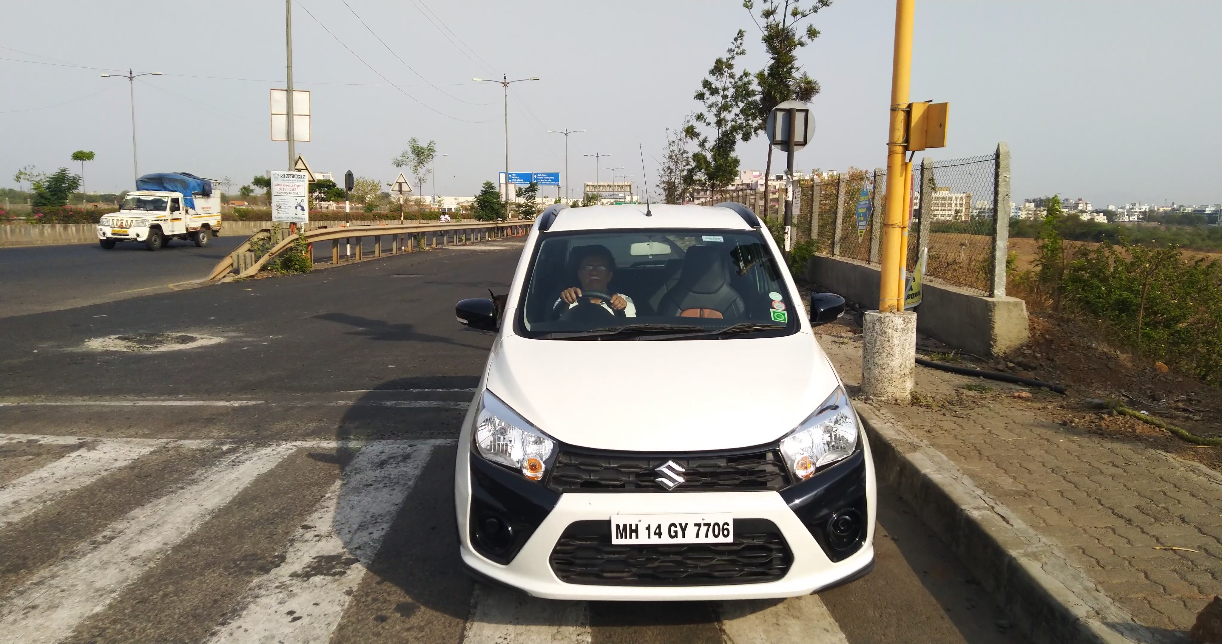
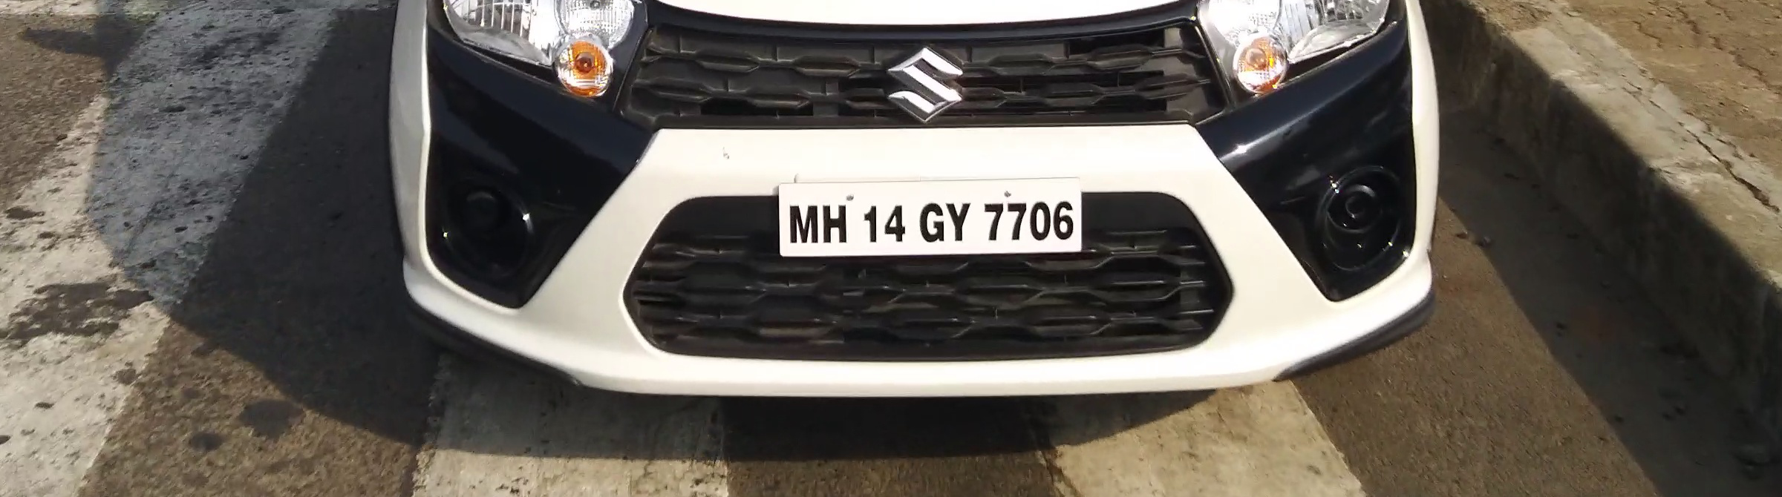
Methodology
Input
Video - When traffic signal is red.
Create image frames from video.
Pre-Processing
Input Image
Crop Image

Slide 12
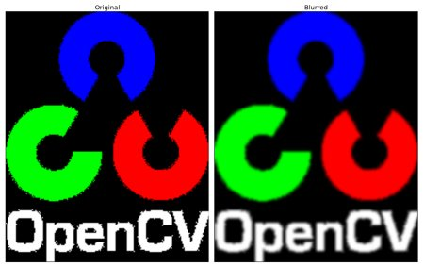
Pre-Processing
Gaussian Blur :
Gaussian blurring is highly effective in removing gaussian noise from the image.
ImgBlurred = cv2.GaussianBlur(img, (5,5), 0)

Slide 13
Pre-Processing
Convert RGB to Gray Image -
RGB - Gray : Y <- 0.299 * R + 0.587 * G + 0.114 * B
This is done with the help of cvtColor() from cv.
Threshold -
Sobel operator is descrete differentiation operator. It compute an approximation of the gradient of an image intensity function.
sobelx = cv2.Sobel(gray,cv2.CV_8U,1,0,ksize=5)
th2=cv.threshold(sobelx,0,255,cv.THRESH_BINARY+cv.THRESH_ OTSU)

Slide 14
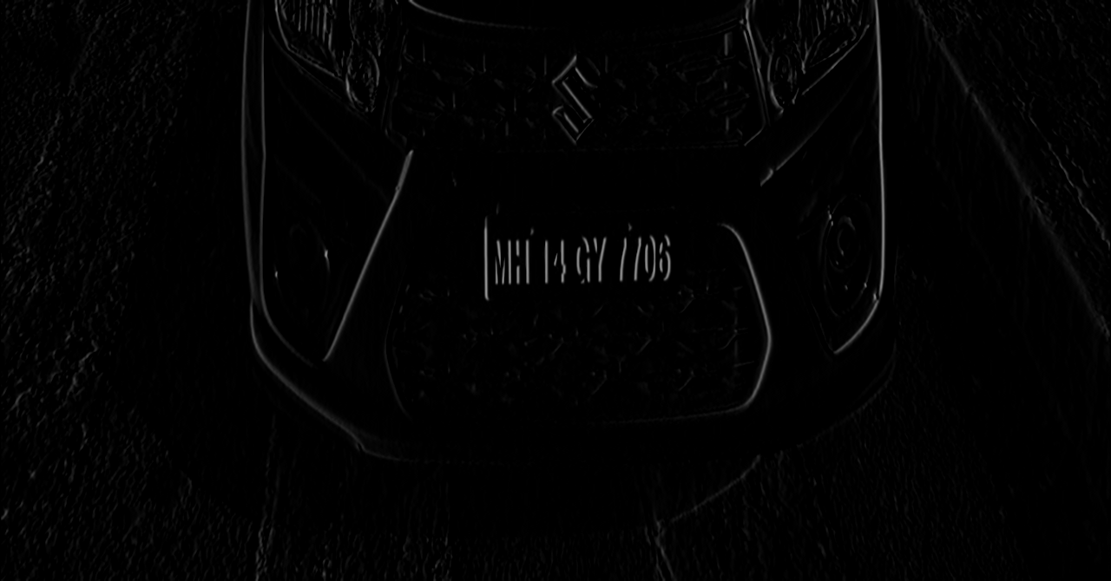
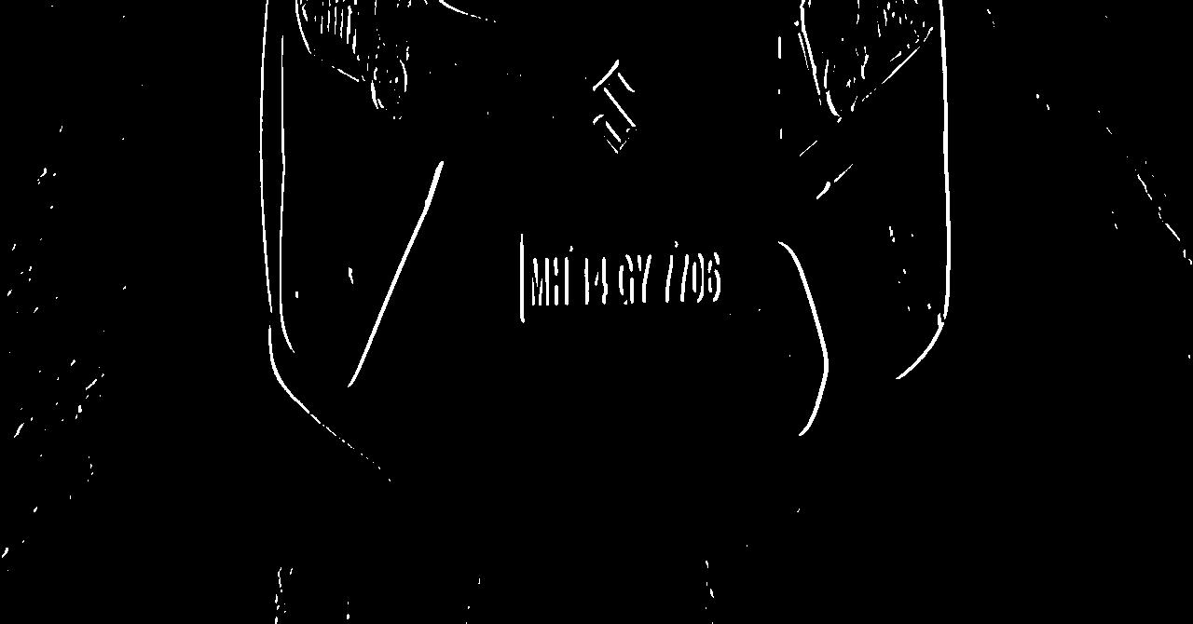
Input Image
Sobel Image
Threshold Image

Slide 15
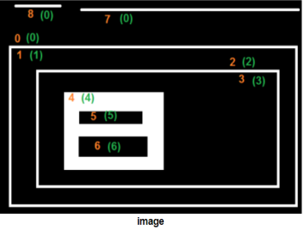
Pre-Processing
Get Structuring Element (Rectangle):
element = cv2.getStructuringElement(shape=cv2.MORPH_RECT,ksize(17,3))
Closing
Used for closing small holes in object
cv2.morphologyEx(src=threshod_img, op=cv2.MORPH_CLOSE, kernel=element, dst=morph_img_threshold)
Find Contours
Contours indicate the boundary pixels of objects

Slide 16
Pre-Processing
contours = cv2.findContours(morph_img_threshold,mode=cv2.RETR_EXTERNAL,method=cv2.CHAIN_APPROX_NONE)
First parameter is source image (morph_img_threshold) ,
Second parameter is contour retrieval mode mode=cv2.RETR_EXTERNAL, using this mode only outer edges are returned
Third is contour approximation method.
Bounding Rectangle
x,y,w,h = cv2.boundingRect(cnt)
(x,y) top left corner co-ordinates of plate
w = width
h = heigth
Plate image can be obtained by adding co- ordinates and width and height.
Hence number plate is detected.

Slide 17
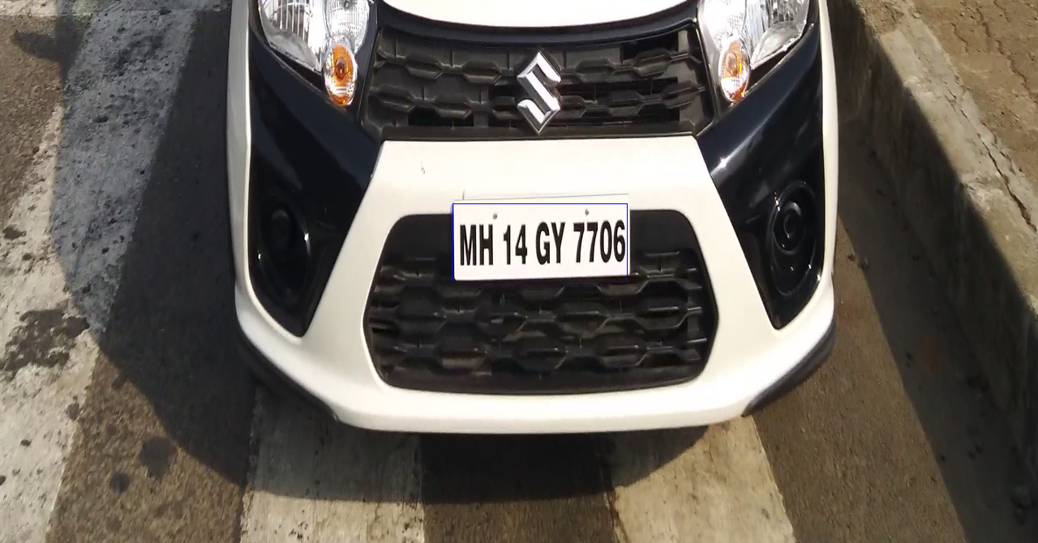
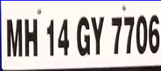
Pre-Processing
Number Plate Detected

Slide 18
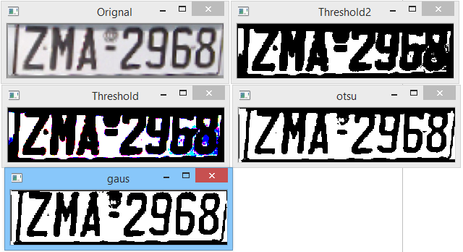
Pre-Processing
Creating Threshold Image
Gaussian
Threshold
Threshold (Gray)
Otsu

Slide 19
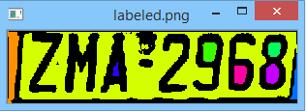
Pre-Processing
Connected Component Analysis
Map component labels to hue value
cvt to BGR for display
set background label to black

Slide 20
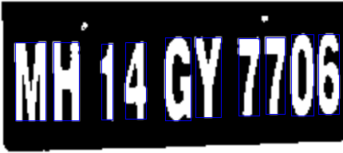

Pre-Processing
Resize the image
Contour Creation
Rectangle of specified size
Match pixels

Slide 21
Feature Extraction
Optical Character Recognition
Using Tesseract python library
from tesseract import image_to_string
print image_to_string(Image.open('test-english.jpg'), lang='eng')
Output:-
MH14GY7706

Slide 22
Verification
Database Verification
SQL database of vehicle owners
E-challan Generation
Api for sms sending : way2sms

Slide 23
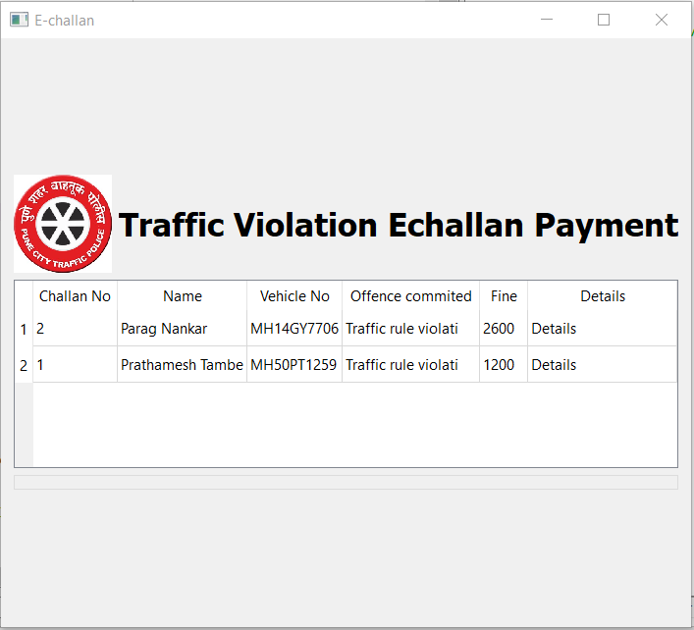
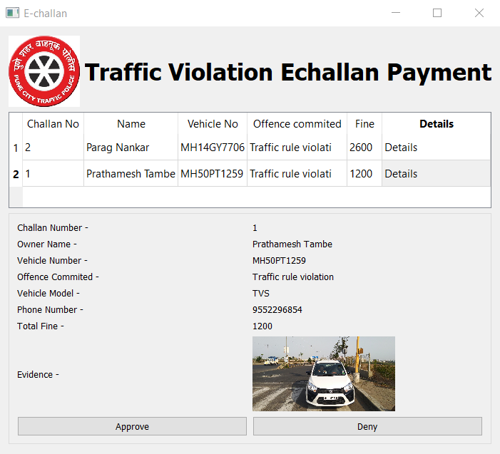
Results
Initial Window
After clicking user 1

Slide 24
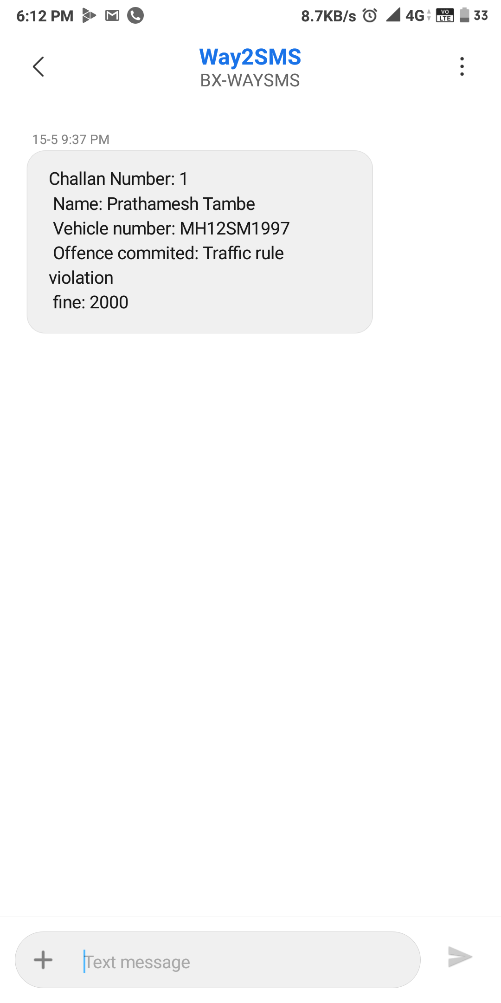
Results

Slide 25
References
[1] TANG Yufeng, LUO Bin,TANG Jin, WU Fubu. New heuristic algorithm of license plate location based on statistical feature.[J] Computer Engineering and
Application, 2015,51(6): 154-158.
[2] Abolghasemi V, Ahmadyfard A. An edge-based color-aidedmethod for license plate detection[J]. Image & Vision Computing, 2009, 27(8):1134-1142.
[3] Comelli P,Ferragina P,Granieri M N. Optical Recognition of Motor Vehicle License Plates[J], Vehicular Technology, IEEE Transactions on, 1995,44: 790-799.
[4] SI Qing-ya. The design and implementation of License Plate Recognition System based on robust illumination[D]. Nanjing: Nanjing University of Posts and
Telecommunications, 2013.
[5] Deneen K M V. An Algorithm for License Plate Recognition Applied to Intelligent Transportation System[J]. IEEE Transactions on Intelligent Transportation Systems, 2011, 12(3):830-845.

